Slide 1

ML Engineer Role
1. Introduction to Machine Learning
2. ML Fundamentals
3. Data Preprocessing
4. Model Development
5. LLMs & Generative AI
6. Retrieval-Augmented Generation (RAG)
7. Cloud ML Platforms
8. ML API Integrations
9.System Design for ML
10.Containers & Deployment
11. MLOps & Monitoring
12. Security in ML
Comprehensive Overview of ML Topics
By Magesh J

Slide 2
Introduction
📊 Data → 🤖 Machine Learning Model → 📈 Predictions/Decisions
🔹 What is ML?
A branch of Artificial Intelligence (AI) that enables systems to learn from data and improve without being explicitly programmed.
Focuses on patterns and predictions rather than hard-coded rules.
🔹 Why it Matters?
Powers real-world applications: recommendation systems, fraud detection, chatbots, self-driving cars.
Helps businesses make data-driven decisions.
Reduces manual effort and improves accuracy & efficiency.

Slide 3

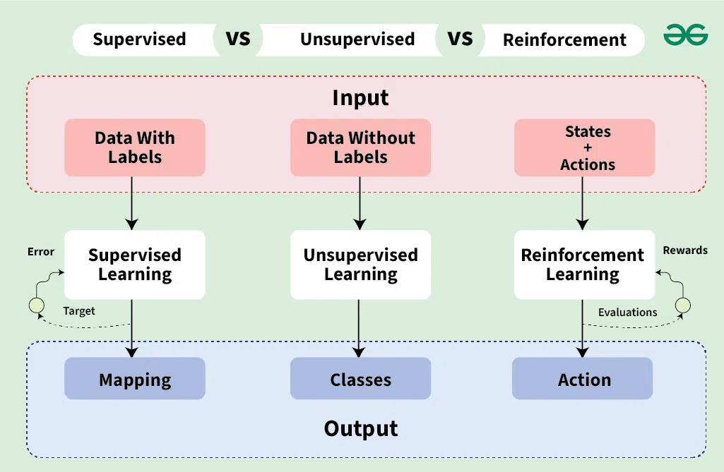
Machine Learning
Fundamentals

Slide 4
Types of Learning: Supervised, Unsupervised, Reinforcement
🔹 1. Supervised Learning
Regression → Predicts continuous values (e.g., house price).
Classification → Predicts discrete labels (e.g., spam or not).
🔹 2. Unsupervised Learning
Clustering → Groups similar data points (e.g., customer segments).
Association → Finds relationships between variables (e.g., market basket).
🔹 3. Reinforcement Learning
Value-Based → Learns the best action by maximizing rewards (e.g., Q-Learning).
Policy-Based → Learns a policy to decide actions (e.g., Actor-Critic).
Model-Based → Builds a model of environment to plan actions.
🔹 1. Supervised Learning
Learns from labeled data (input → output).
Example: Predicting house prices, Email spam detection.
🔹 2. Unsupervised Learning
Works on unlabeled data to find patterns.
Example: Customer segmentation, Market basket analysis.
🔹 3. Reinforcement Learning
Learns by trial and error with rewards/penalties.
Example: Self-driving cars, Game-playing AI.

Slide 5

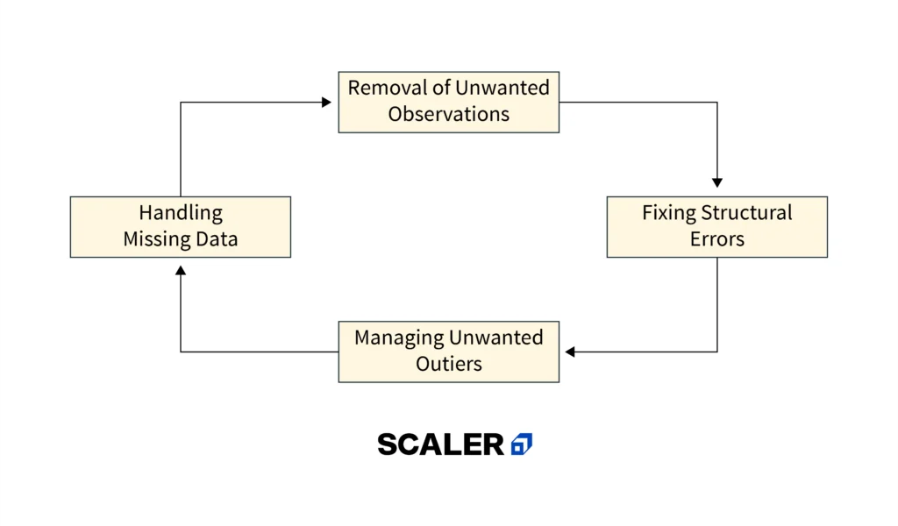
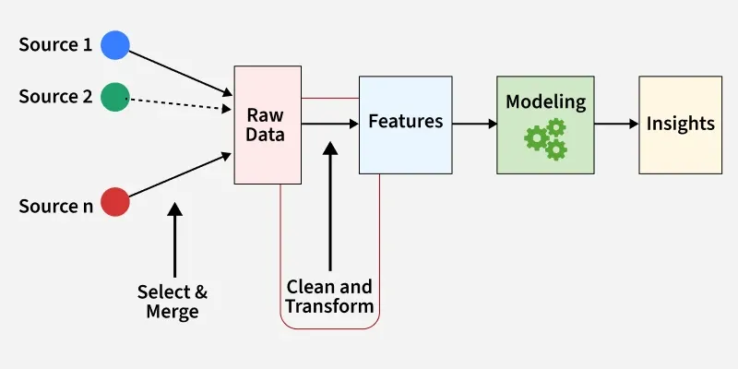
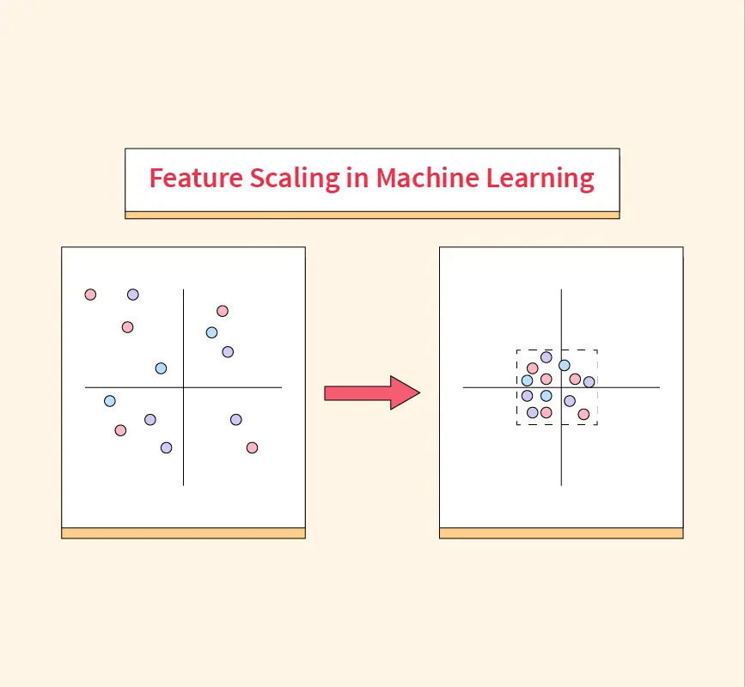
Data Preprocessing Techniques:
🔹 1. Data Cleaning
Handle missing values (mean/median imputation, remove rows).
Remove duplicates.
Correct inconsistent data (typos, formatting).
Handle outliers.
🔹 2. Feature Engineering
Create new features from existing ones.
Encode categorical variables (One-hot, Label encoding).
Extract meaningful information (e.g., date → day, month).
🔹 3. Scaling
Normalize/Standardize numerical data.
Min-Max Scaling (0–1).
Standard Scaling (mean=0, variance=1).
Ensures fair comparison between features.

Slide 6
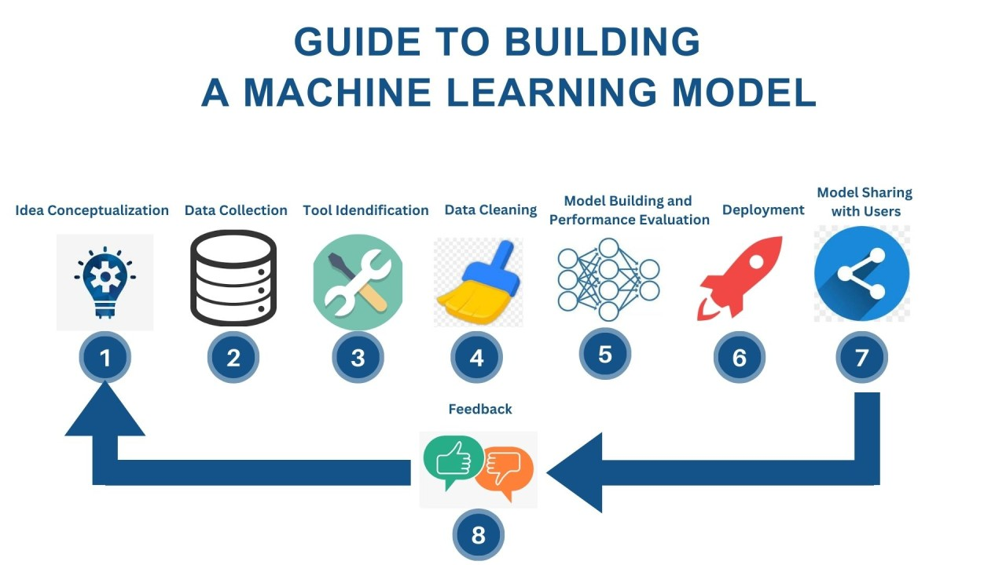
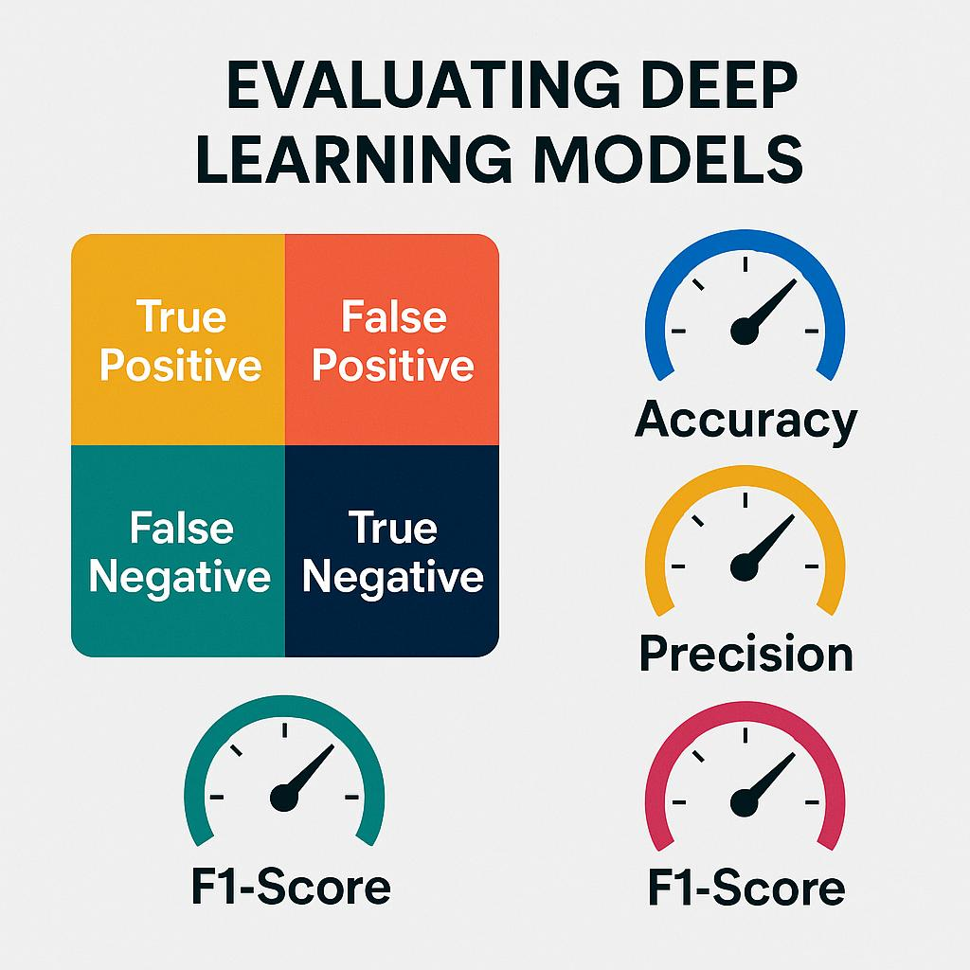

Model Development and Evaluation Metrics: Training, Accuracy, Precision, Recall, F1 Score
🔹 Training Process
Input data → Model → Predictions
Model adjusts internal parameters using training data
Goal: minimize loss function (difference between predictions & actual values)
🔹 Evaluation Metrics
Accuracy: $$\left(CorrectPredictions\right)÷\left(TotalPredictions\right)$$
Best when classes are balanced.
Precision: $$TruePositives÷\left(TruePositives+FalsePositives\right)$$
“Of the cases we predicted positive, how many were correct?”
Important for reducing false alarms.
Recall (Sensitivity): $$TruePositives÷\left(TruePositives+FalseNegatives\right)$$
“Of all actual positives, how many did we correctly identify?”
Important for catching as many true cases as possible.
F1 Score: $$2×\left(Precision×Recall\right)÷\left(Precision+Recall\right)$$
Balances Precision & Recall
Useful when data is imbalanced.
🔹 Example (Disease Prediction):
High Recall → Detects almost all patients (few missed cases).

Slide 7

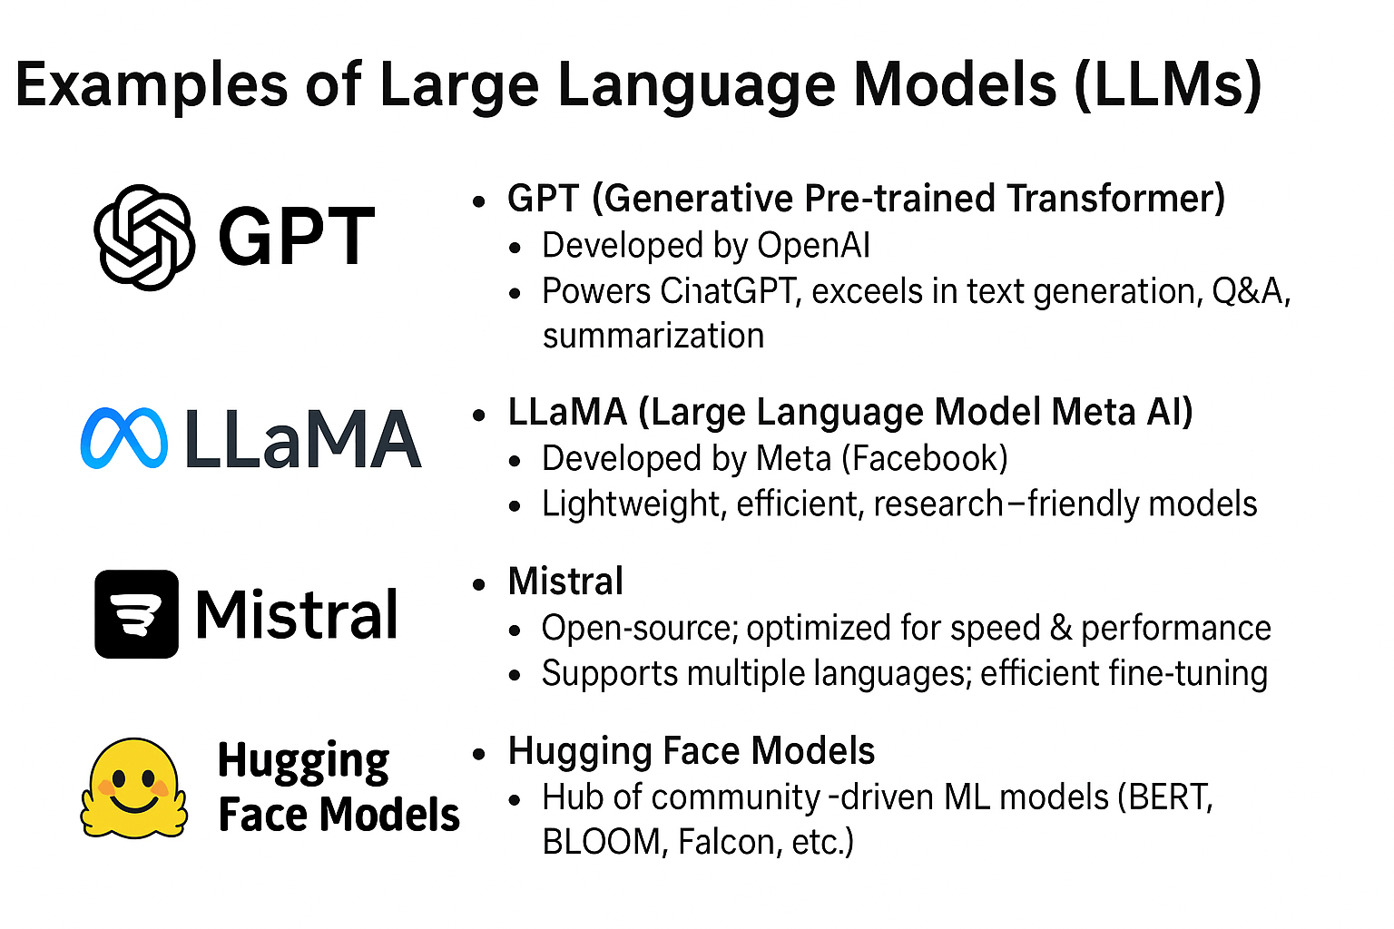
LLMs & Generative AI
🔹 What are LLMs?
AI models trained on massive text data
Understand & generate human-like language
Examples: GPT, LLaMA, Mistral, Hugging Face models
🔹 Generative AI
Creates new content (text, images, audio, code)
Uses deep learning & transformer architectures

Slide 8
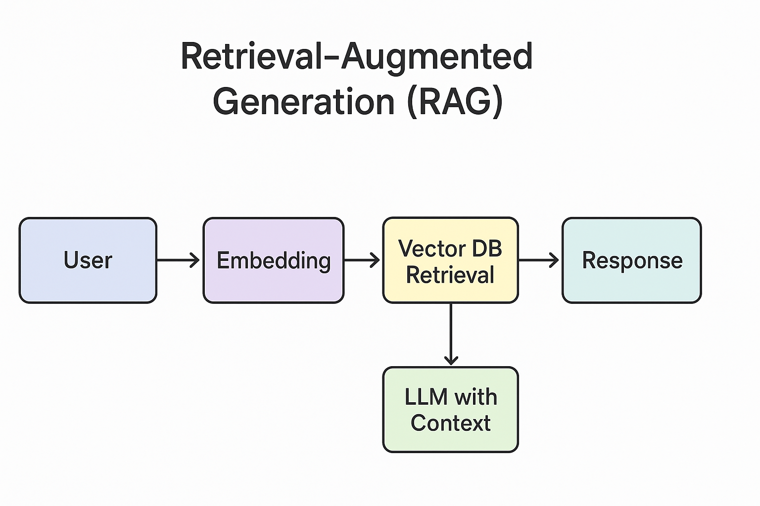
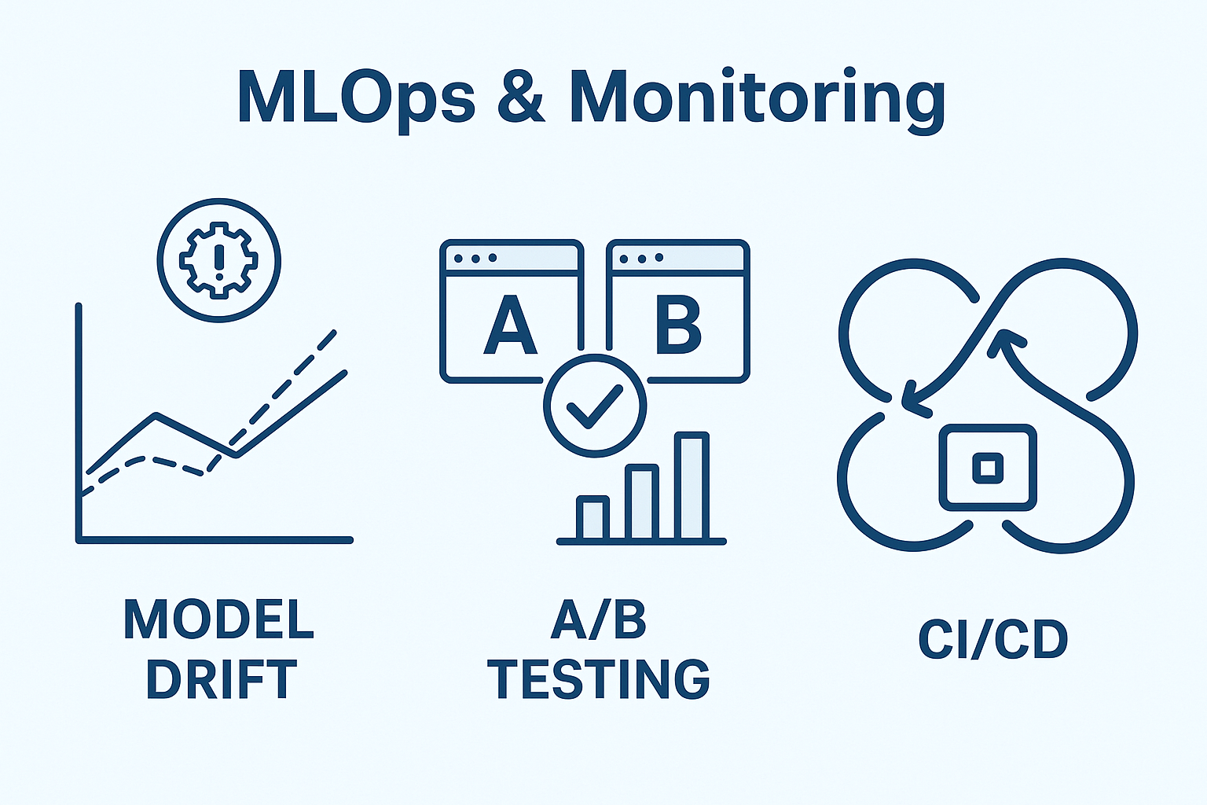
Retrieval-Augmented Generation (RAG) → Embeddings, vector databases, hybrid
Retrieval-Augmented Generation (RAG)
Definition: A framework that enhances LLMs by retrieving external knowledge before generating responses.
Process:
User Query → Converted into embedding.
Retriever → Searches knowledge base (vector DB / hybrid).
LLM → Uses retrieved context + query to generate accurate response.
Why RAG?
Reduces hallucination.
Keeps responses updated with latest information.
Domain-specific customization (enterprise data, research, etc.).

Slide 9
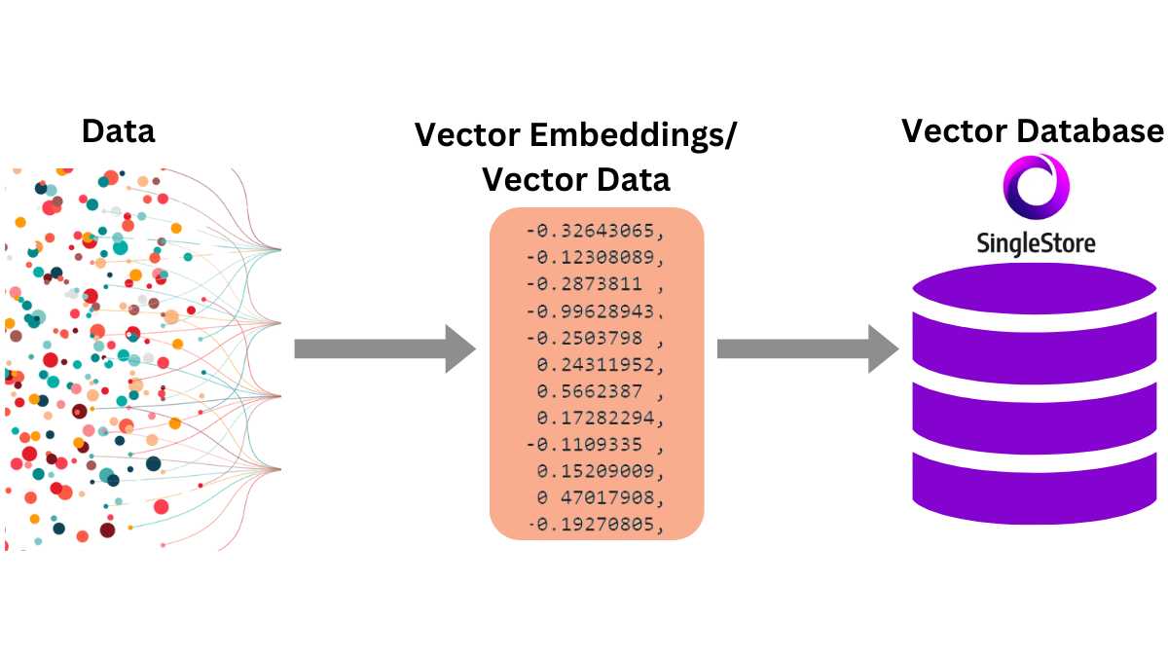
Embeddings
What: Representation of text (or image, audio) in high-dimensional vectors.
How: Semantically similar texts are closer in vector space.
Use:
Semantic search (beyond keyword match).
Clustering, recommendations, document similarity.
Example:
“Doctor” and “Physician” → Close vectors.
“Doctor” and “Banana” → Distant vectors.
Vector Databases
Purpose: Store and search embeddings efficiently>
Key Features:
Similarity Search: Cosine similarity, dot product, Euclidean distance.
Indexing: HNSW, IVF, PQ for fast retrieval at scale.
Integration: APIs for LLMs and applications.
Examples: Pinecone, Weaviate, Milvus, FAISS, Qdrant.
Hybrid Search
Definition: Combines vector search (semantic) with keyword/BM25 (lexical).
Why Needed:
Semantic search understands context, but may miss exact terms.
Keyword search ensures precision for numbers, names, codes.
Result: Best of both → high recall + high precision.
Use Cases: Legal documents, medical data, enterprise search.

Slide 10
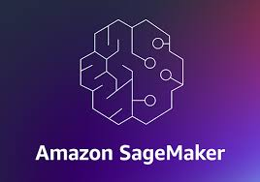
Cloud Platform
A cloud platform is a set of online services and tools provided by cloud providers that allow users to build, deploy, and manage applications or ML models without needing on-premise infrastructure.
It provides on-demand computing resources (servers, storage, databases, AI/ML tools) over the internet.
Supports scalability, flexibility, and cost-efficiency.
AWS SageMaker
Definition: Fully managed ML service on AWS for building, training, and deploying ML models.
Key Features:
Pre-built algorithms & Jupyter notebooks for quick start.
AutoML (Autopilot): Automatically trains & tunes models.
Training & Inference: Scalable distributed training + real-time/batch endpoints.
MLOps Tools: Pipelines, Model Registry, Monitoring, CI/CD integration.
Integration: Works seamlessly with S3, Lambda, Redshift, and other AWS services.
Best For: Enterprises needing scalable ML with end-to-end workflow automation.

Slide 11
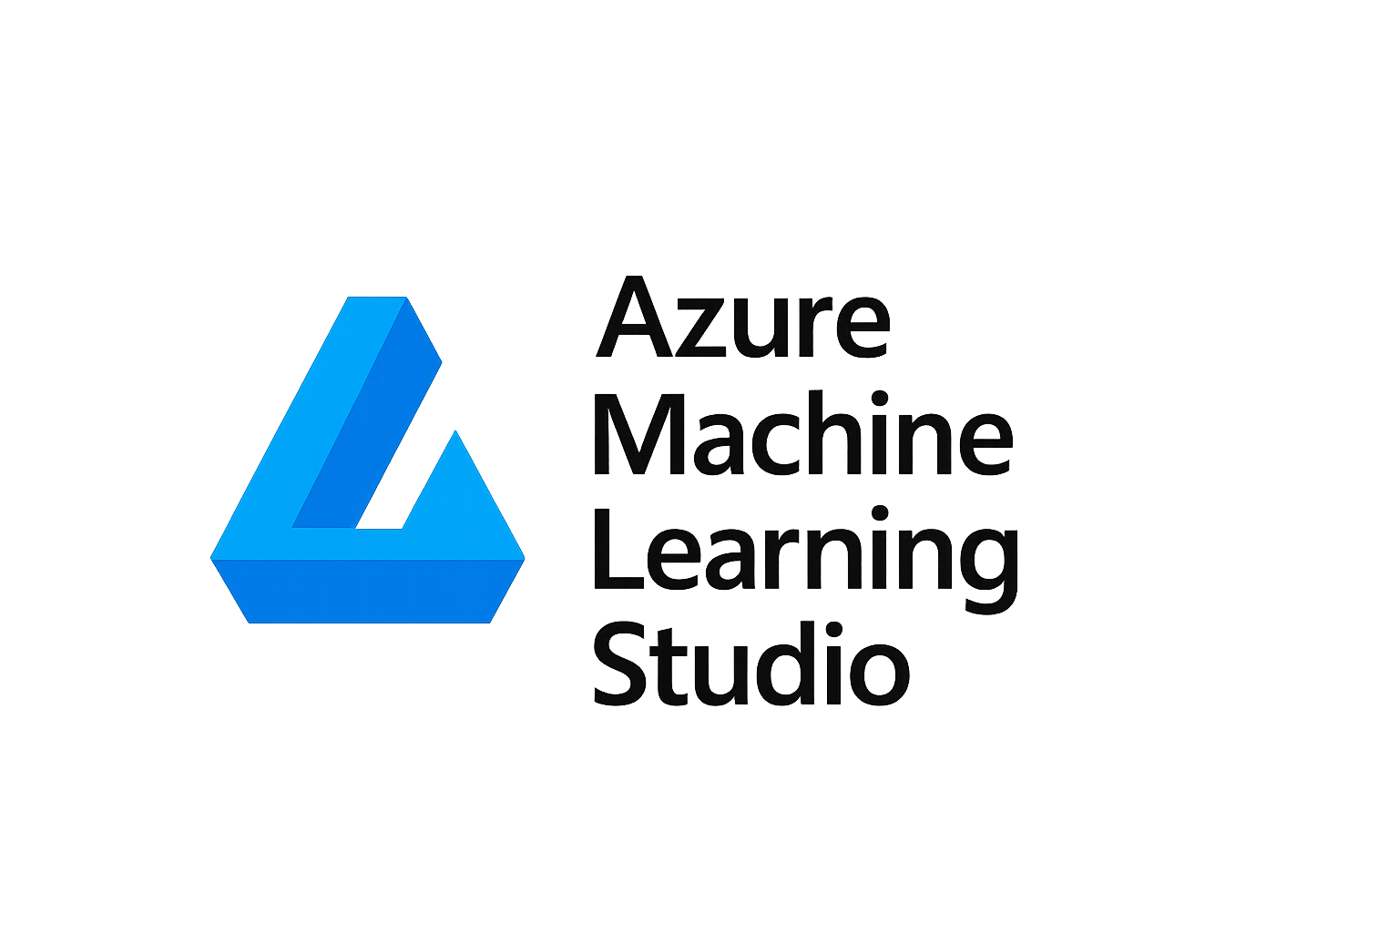
2. Azure ML Studio
Definition: Microsoft’s cloud-based ML platform for building, training, and deploying models.
Key Features:
Drag-and-drop interface : for low-code ML model creation.
Automated ML: Model selection & hyperparameter tuning.
Pipelines & MLOps: Workflow orchestration, deployment, monitoring.
Integration: Works with Power BI, Azure Data Lake, Synapse Analytics.
Deployment Options: Real-time endpoints, batch inference, edge deployment.
Best For: Teams preferring visual workflows, Microsoft ecosystem integration, and collaboration.
Comparison Snapshot :
Feature | AWS SageMaker | Azure ML Studio
Interface | Code-first (Python SDK, Jupyter) | Drag-and-drop + Python SDK
Automation | SageMaker Autopilot (AutoML) | Azure AutoML (Model selection/tuning)
Integration | AWS ecosystem (S3, Lambda, Redshift) | Microsoft ecosystem (Power BI, Azure Data)
Deployment | Real-time, batch, multi-model endpoints | Real-time, batch, edge deployments
Target Audience | Data scientists, ML engineers | Business analysts, citizen data scientists

Slide 12
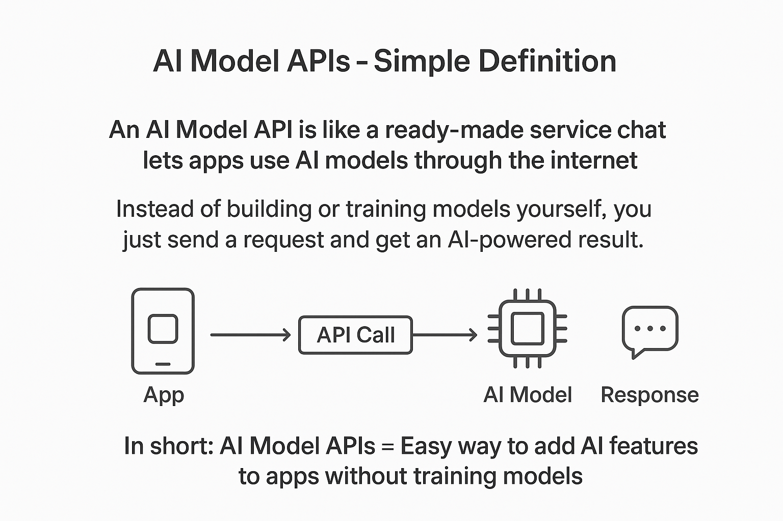
ML API Integration
Notes:
AI Model APIs – Simple Definition
An AI Model API is like a ready-made service that lets apps use AI models through the internet.
Instead of building or training models yourself, you just send a request and get an AI-powered result.
Examples of tasks:
Generate text
Answer questions
Translate language
Recognize images or speech

Slide 13


1. OpenAI API
What: APIs for advanced language & multimodal models (e.g., GPT, DALL·E, Whisper).
Key Features:
Chat & Completion (GPT models).
Vision & Image Generation (GPT-4V, DALL·E).
Speech-to-Text (Whisper).
Fine-tuning & embeddings for custom apps.
Use Cases: Conversational AI, content generation, coding assistants, summarization.
Strength: Powerful state-of-the-art models with wide developer adoption.
2. Hugging Face APIs
What: Open-source hub + APIs for 100k+ ML models, datasets, and pipelines
Key Features:
Transformers Library: Access to BERT, T5, Stable Diffusion, LLaMA, etc.
Inference API: Run models instantly in the cloud.
Spaces: Deploy ML apps with Gradio/Streamlit.
AutoTrain: Train models without coding.
Use Cases: NLP, CV, audio, multi-modal AI, rapid prototyping.
Strength: Community-driven, open-source, flexible ecosystem.

Slide 14
3. Anthropic APIs
What: APIs for Claude, a family of conversational and reasoning-focused AI models.
Key Features:
Claude 1, 2, 3 Models for safe, helpful, and steerable responses.
Focus on Constitutional AI → safer alignment methods.
Large context window (supports longer conversations/documents).
Text understanding, summarization, Q&A, coding
.
Use Cases: Enterprise chatbots, knowledge assistants, safe AI deployment.
Strength: Safety-first design, long context, enterprise adoption.
Comparison Snapshot
Feature | OpenAI | Hugging Face | Anthropic
Focus | State-of-the-art proprietary models | Open-source models & community | Safe & steerable conversational AI
Key Models | GPT, DALL·E, Whisper | BERT, T5, Stable Diffusion, LLaMA | Claude (1, 2, 3 series)
Strength | Best-in-class performance | Flexibility, wide model choice | Safety, long context reasoning
Use Cases | Chatbots, content, coding | NLP, CV, prototyping, ML apps | Enterprise assistants, safe AI

Slide 15

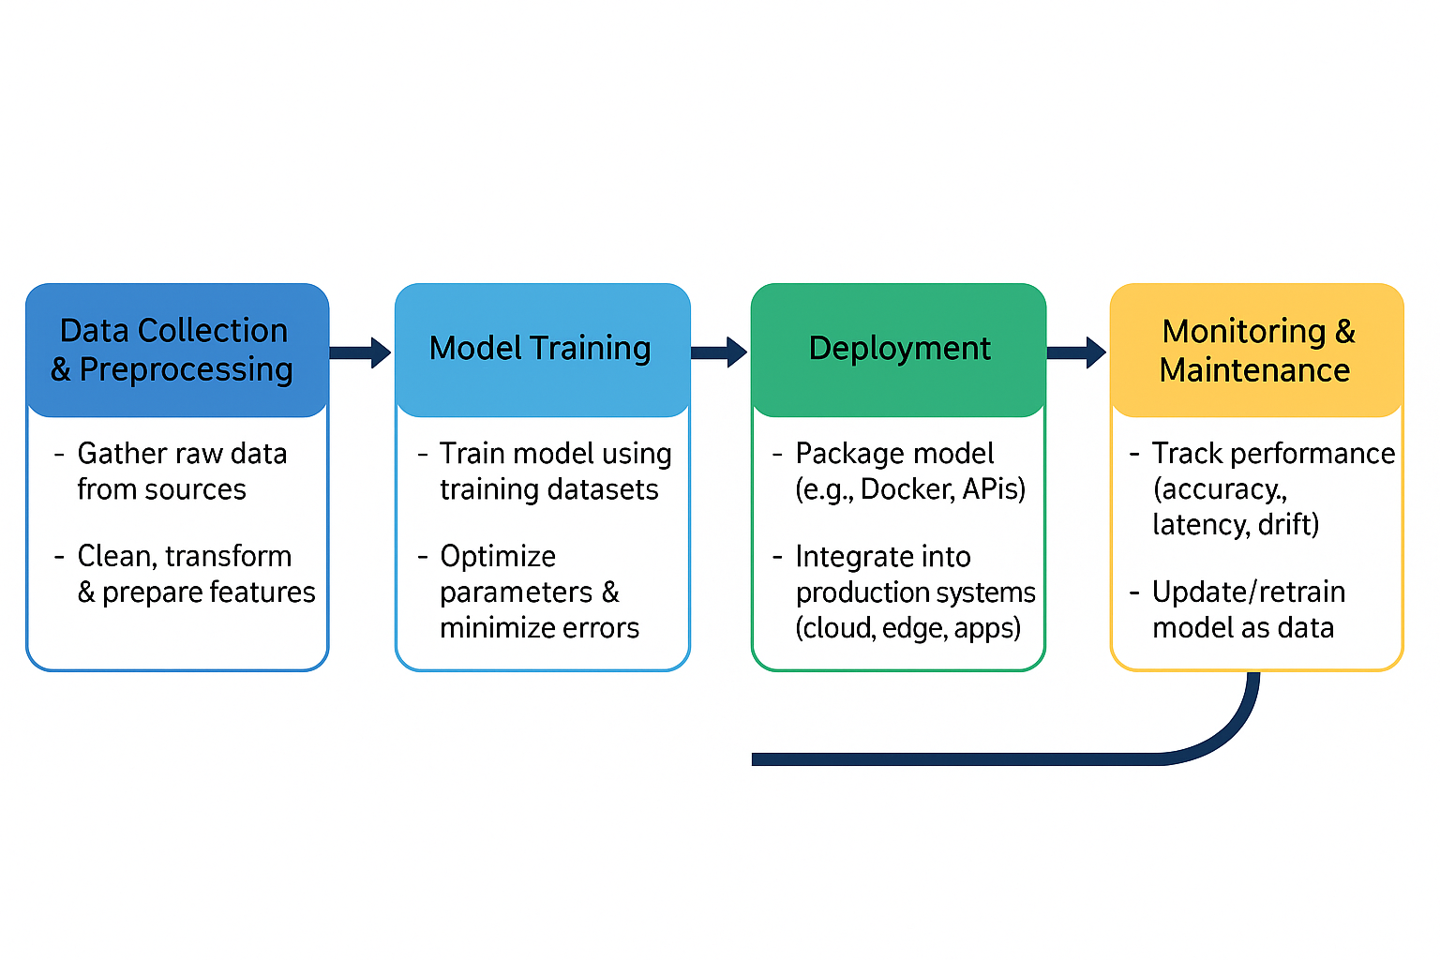
System Design for ML – End-to-end ML pipeline
🔹 Data Collection & Preprocessing
Gather raw data from sources
Clean, transform & prepare features
🔹 Model Training
Train models using training datasets
Optimize parameters & minimize errors
🔹 Deployment
Package model (e.g., Docker, APIs)
Integrate into production systems (cloud, edge, apps)
🔹 Monitoring & Maintenance
Track performance (accuracy, latency, drift)
Update/retrain model as data changes

Slide 16
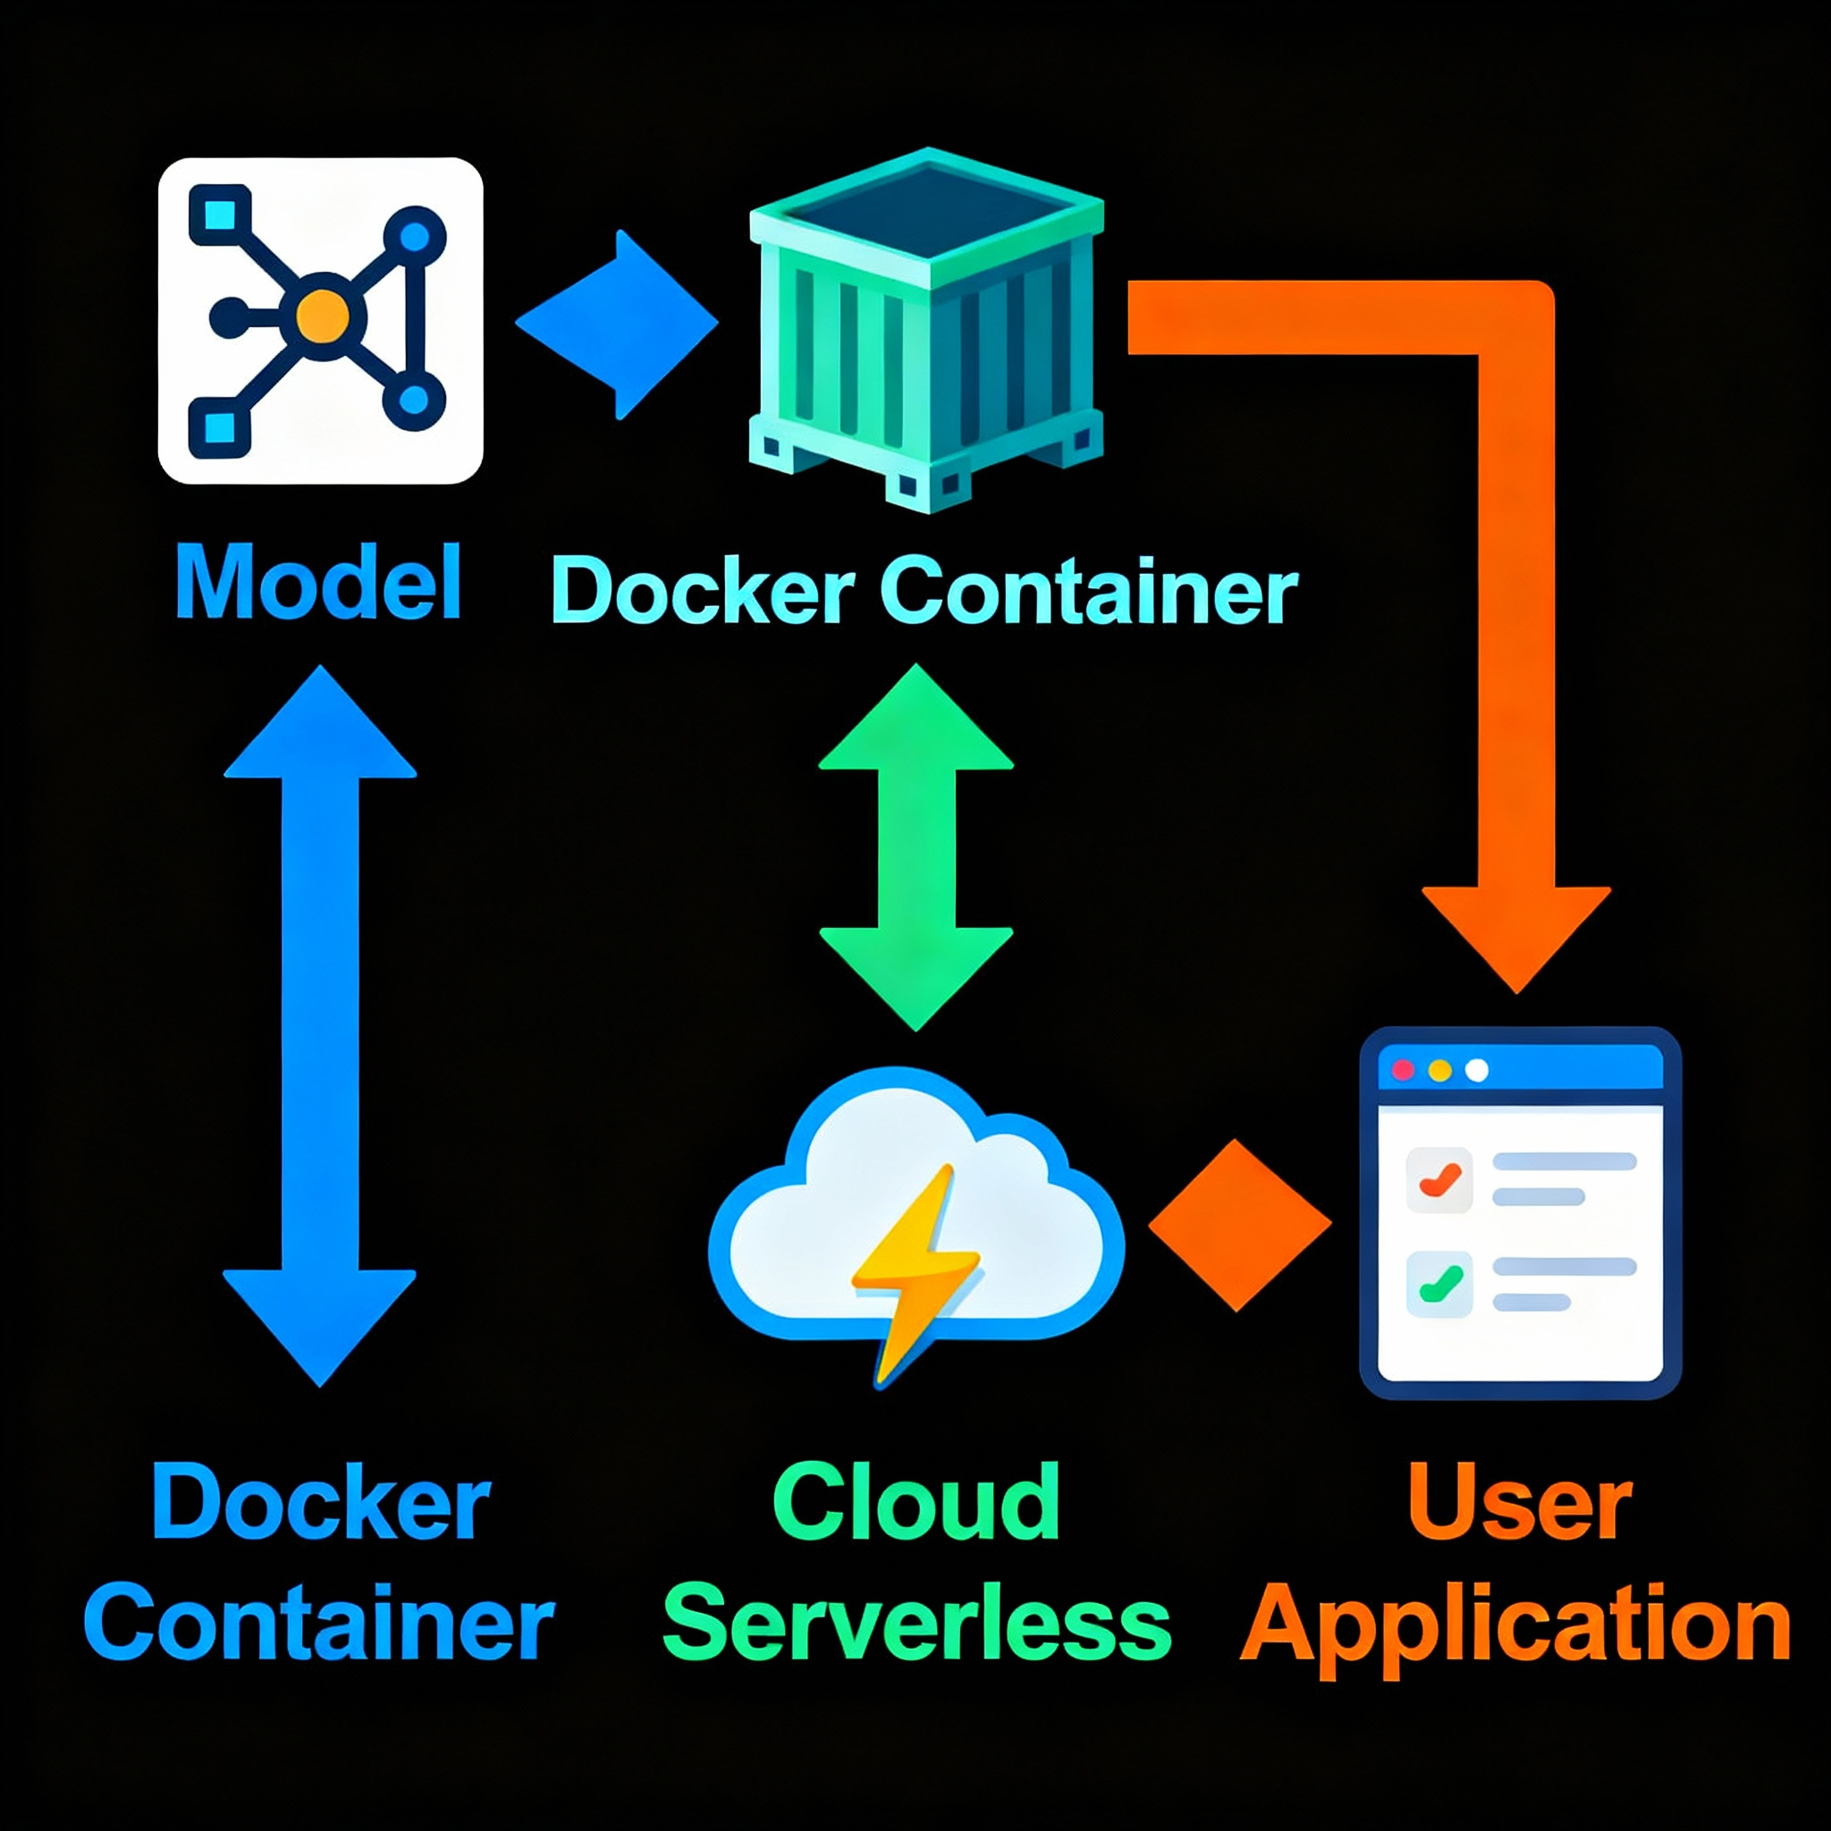
Containers & Deployment – Dockerizing ML models, serverless deployment.
Containers & Deployment
🔹 Dockerizing ML Models
Package model + dependencies into a portable container
Ensures consistent execution across environments
Easy scaling with Kubernetes
🔹 Serverless Deployment
Deploy models without managing servers
Pay-per-use: scalable & cost-efficient
Examples: AWS Lambda, Azure Functions, Google Cloud Functions
🔹 Why It Matters
Faster deployment & portability
Simplifies scaling in production
Reduces infrastructure overhead

Slide 17
MLOps & Monitoring
Model Drift:
Continuous monitoring detects when real-world data changes reduce model performance. Retraining or updating the model is essential to maintain accuracy and business value.
A/B Testing:
Compares multiple model versions in parallel, allowing teams to assess which variant delivers better user or business outcomes before a full rollout.
CI/CD for ML:
Establishes automated pipelines for integrating, testing, and deploying ML models. This ensures reliable, repeatable, and rapid release cycles while enabling model versioning, scalable deployments, and rollback in case of issues.
MLOps (Machine Learning Operations) is a set of practices and tools that streamlines and automates the end-to-end lifecycle of machine learning models—from development to deployment, monitoring, and ongoing maintenance. It bridges the gap between data science and IT/operations, enabling teams to efficiently collaborate, deliver reliable models, and ensure continuous adaptation to changing data and business needs.
Monitoring in MLOps involves tracking model performance, detecting data drift, and maintaining accuracy to help organizations maximize the business impact of their AI solutions

Slide 18

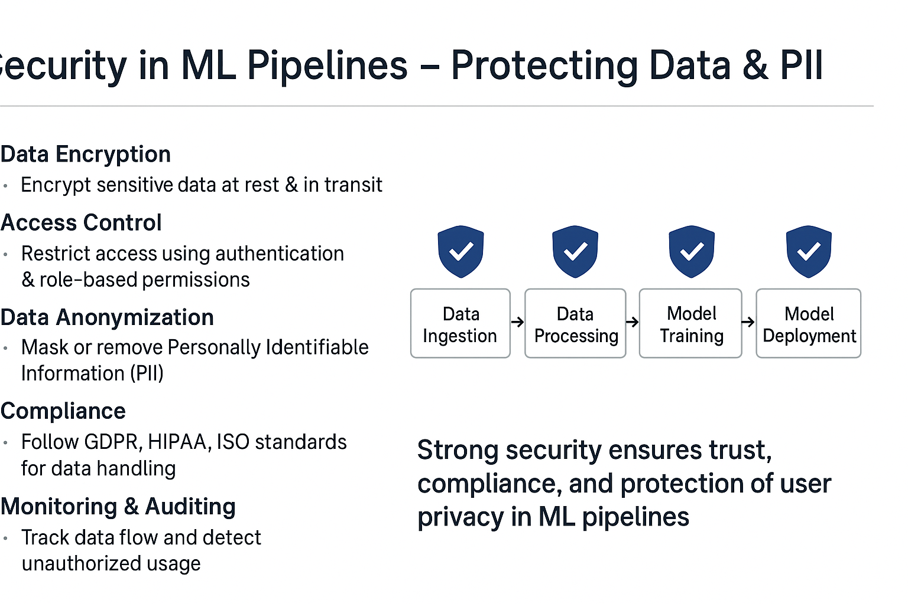
Security in ML Pipelines
Data Encryption: Encrypt sensitive data at rest & in transit.
Access Control: Restrict access using authentication & role-based permissions.
Data Anonymization: Mask or remove Personally Identifiable Information (PII).
Compliance: Follow GDPR, HIPAA, ISO standards for data handling.
Monitoring & Auditing: Track data flow and detect unauthorized usage.
Secure Storage: Use secure cloud storage & key management systems.

Slide 19

Conclusion
“Strong ML knowledge + practical implementation skills = readiness for real-world challenges”
Prepared By: Magesh J

